Slide 1


Version control with git and GitHub
Kim Dill-McFarland
R-ladies Seattle · Jan 14, 2021
kadm@uw.edu @kdillmcfarland Slides https://tinyurl.com/yxz9llyu

Slide 2
An introduction to git tools to help you collaborate across space and time
Why version control?
Collaborate with yourself
Collaborate with others
Share with the world!
kadm@uw.edu @kdillmcfarland Slides https://tinyurl.com/yxz9llyu

Slide 3
Version control
Date files
Short and long time scale issues
Version numbers (v1.0.0)
Distributed (git)
kadm@uw.edu @kdillmcfarland Slides https://tinyurl.com/yxz9llyu

Slide 4

kadm@uw.edu @kdillmcfarland Slides https://tinyurl.com/yxz9llyu

Slide 5
Distributed version control
Time-stamp
Comment
Author
kadm@uw.edu @kdillmcfarland Slides https://tinyurl.com/yxz9llyu

Slide 6
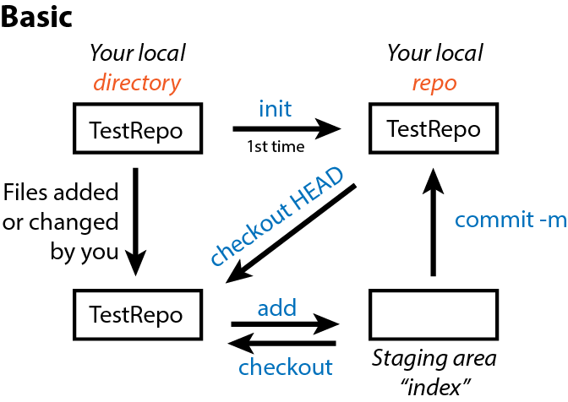
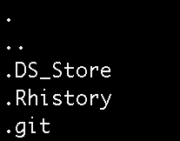
Collaborate with yourself in git
git command line
key terms
kadm@uw.edu @kdillmcfarland Slides https://tinyurl.com/yxz9llyu

Slide 7
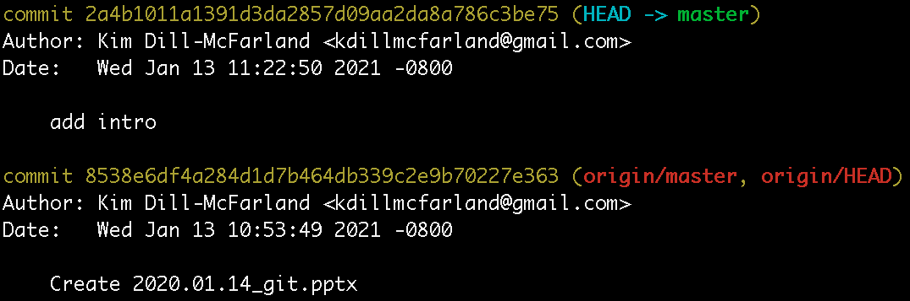
Collaborate over time
kadm@uw.edu @kdillmcfarland Slides https://tinyurl.com/yxz9llyu

Slide 8
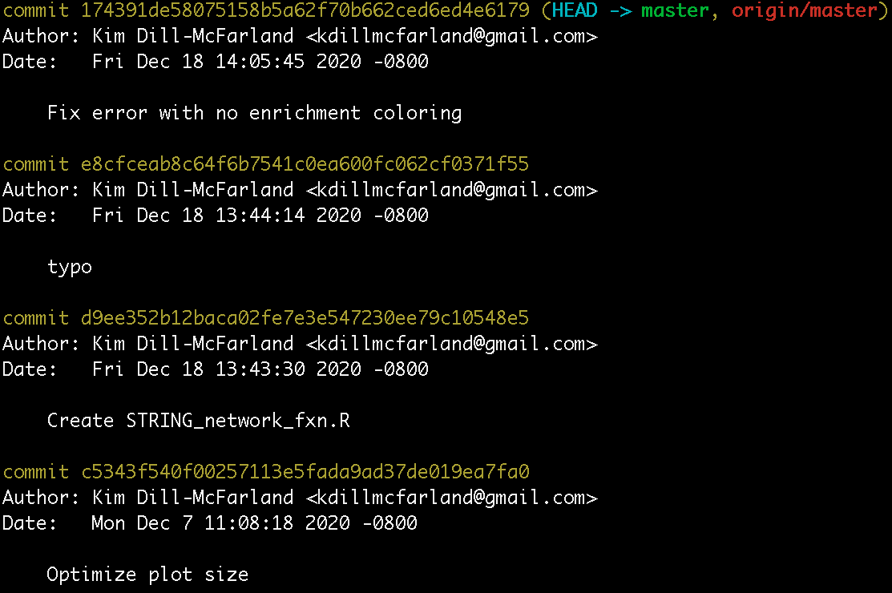
Collaborate over time
kadm@uw.edu @kdillmcfarland Slides https://tinyurl.com/yxz9llyu

Slide 9
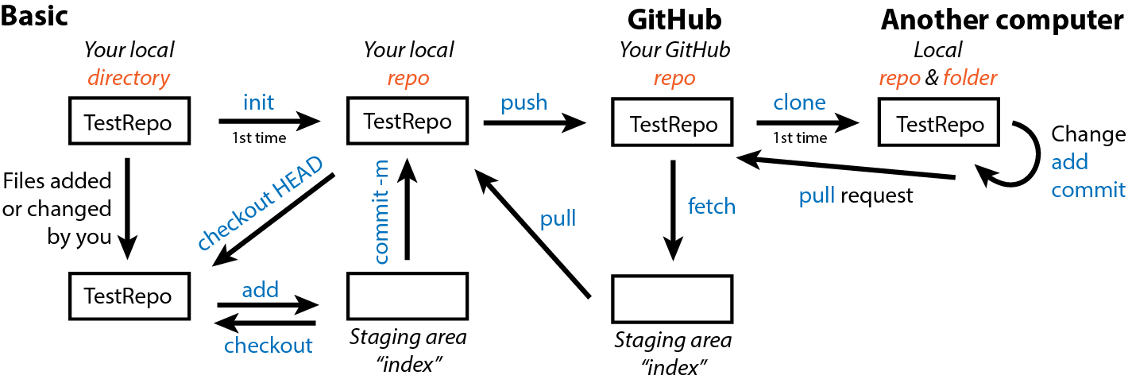
Collaborate over space
git command line
key terms
kadm@uw.edu @kdillmcfarland Slides https://tinyurl.com/yxz9llyu

Slide 10
Collaborate over space
https://github.com/hawn-lab/workshops_UW_Seattle
kadm@uw.edu @kdillmcfarland Slides https://tinyurl.com/yxz9llyu

Slide 11
Collaborate with others
git command line
key terms
Someone else!
kadm@uw.edu @kdillmcfarland Slides https://tinyurl.com/yxz9llyu

Slide 12
Collaborate with others
https://github.com/EDUCE-UBC/workshops/pulls
Closed: Merge introduction to R learnr tutorial
kadm@uw.edu @kdillmcfarland Slides https://tinyurl.com/yxz9llyu

Slide 13
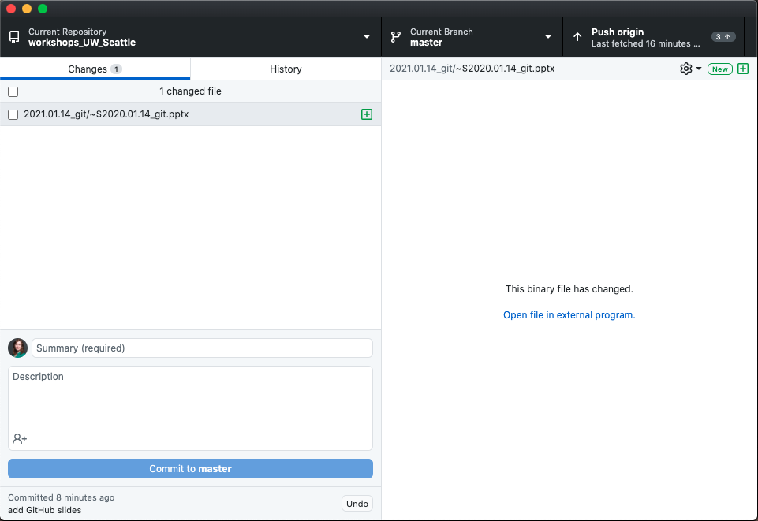
A GUI is nice…
https://desktop.github.com/
kadm@uw.edu @kdillmcfarland Slides https://tinyurl.com/yxz9llyu

Slide 14
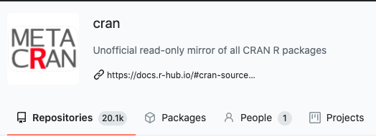
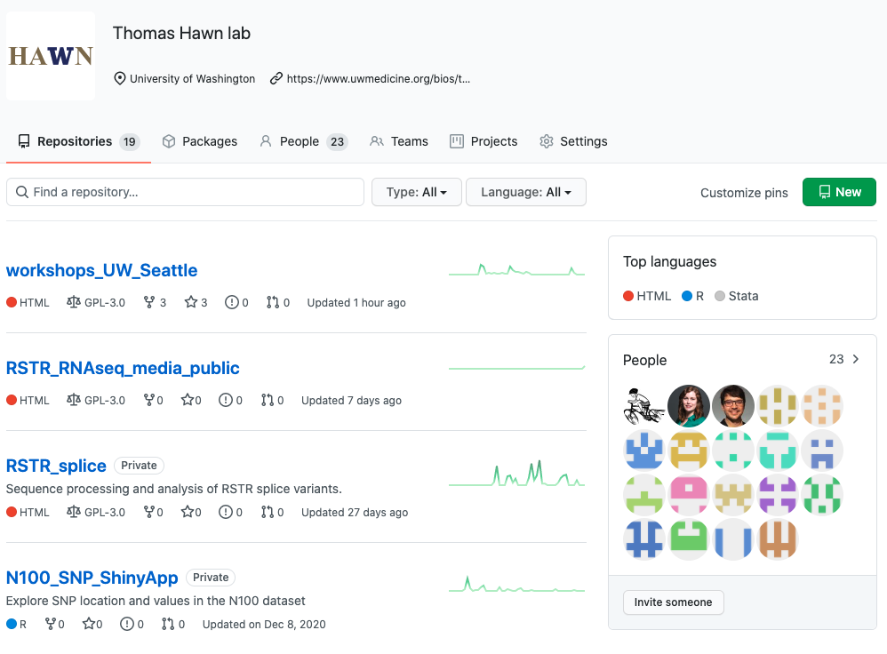
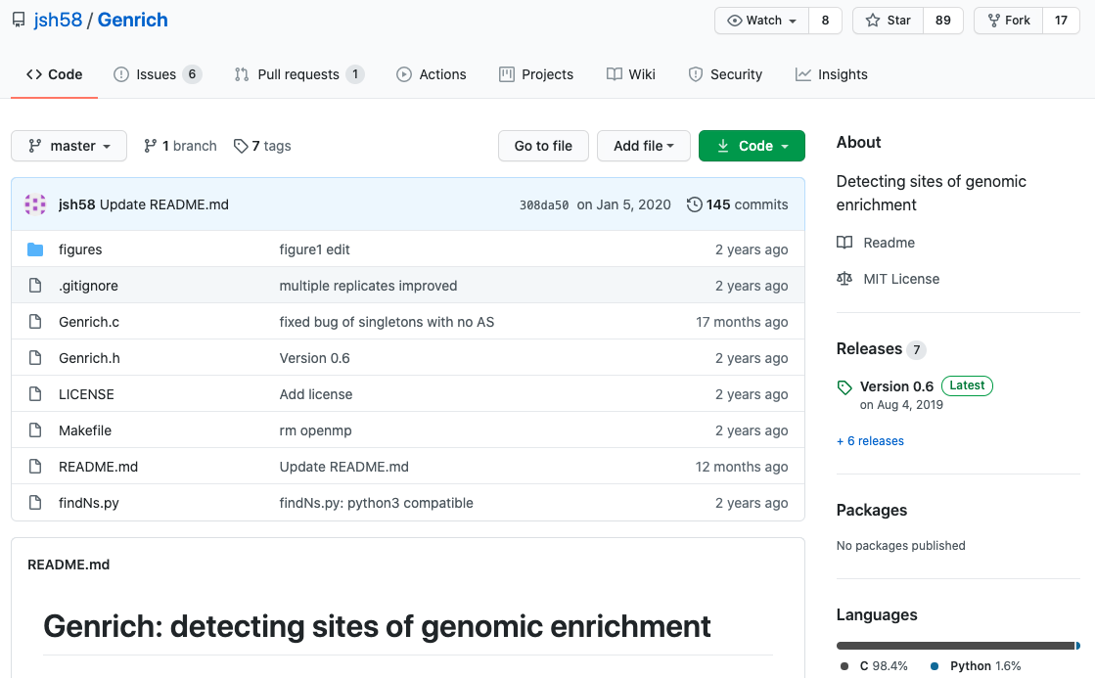
Share with the world!
kadm@uw.edu @kdillmcfarland Slides https://tinyurl.com/yxz9llyu

Slide 15
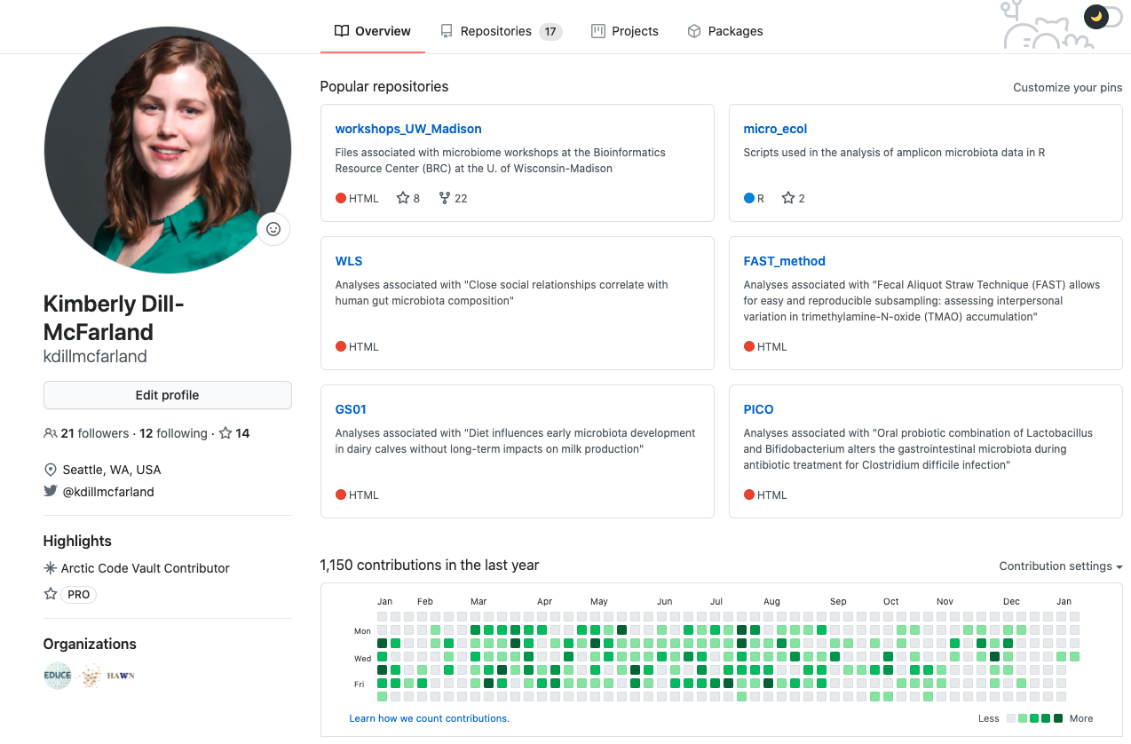
Share with the world!
kadm@uw.edu @kdillmcfarland Slides https://tinyurl.com/yxz9llyu

Slide 16
git and GitHub limitations
Best for text-based files (Rscript, Rmarkdown)
GitHub max file size 100MB
LFS allows larger but not free https://git-lfs.github.com/
Private repos not free
EXCEPT for education and research
https://docs.github.com/en/free-pro-team@latest/education/teach-and-learn-with-github-education/apply-for-an-educator-or-researcher-discount
kadm@uw.edu @kdillmcfarland Slides https://tinyurl.com/yxz9llyu

Slide 17
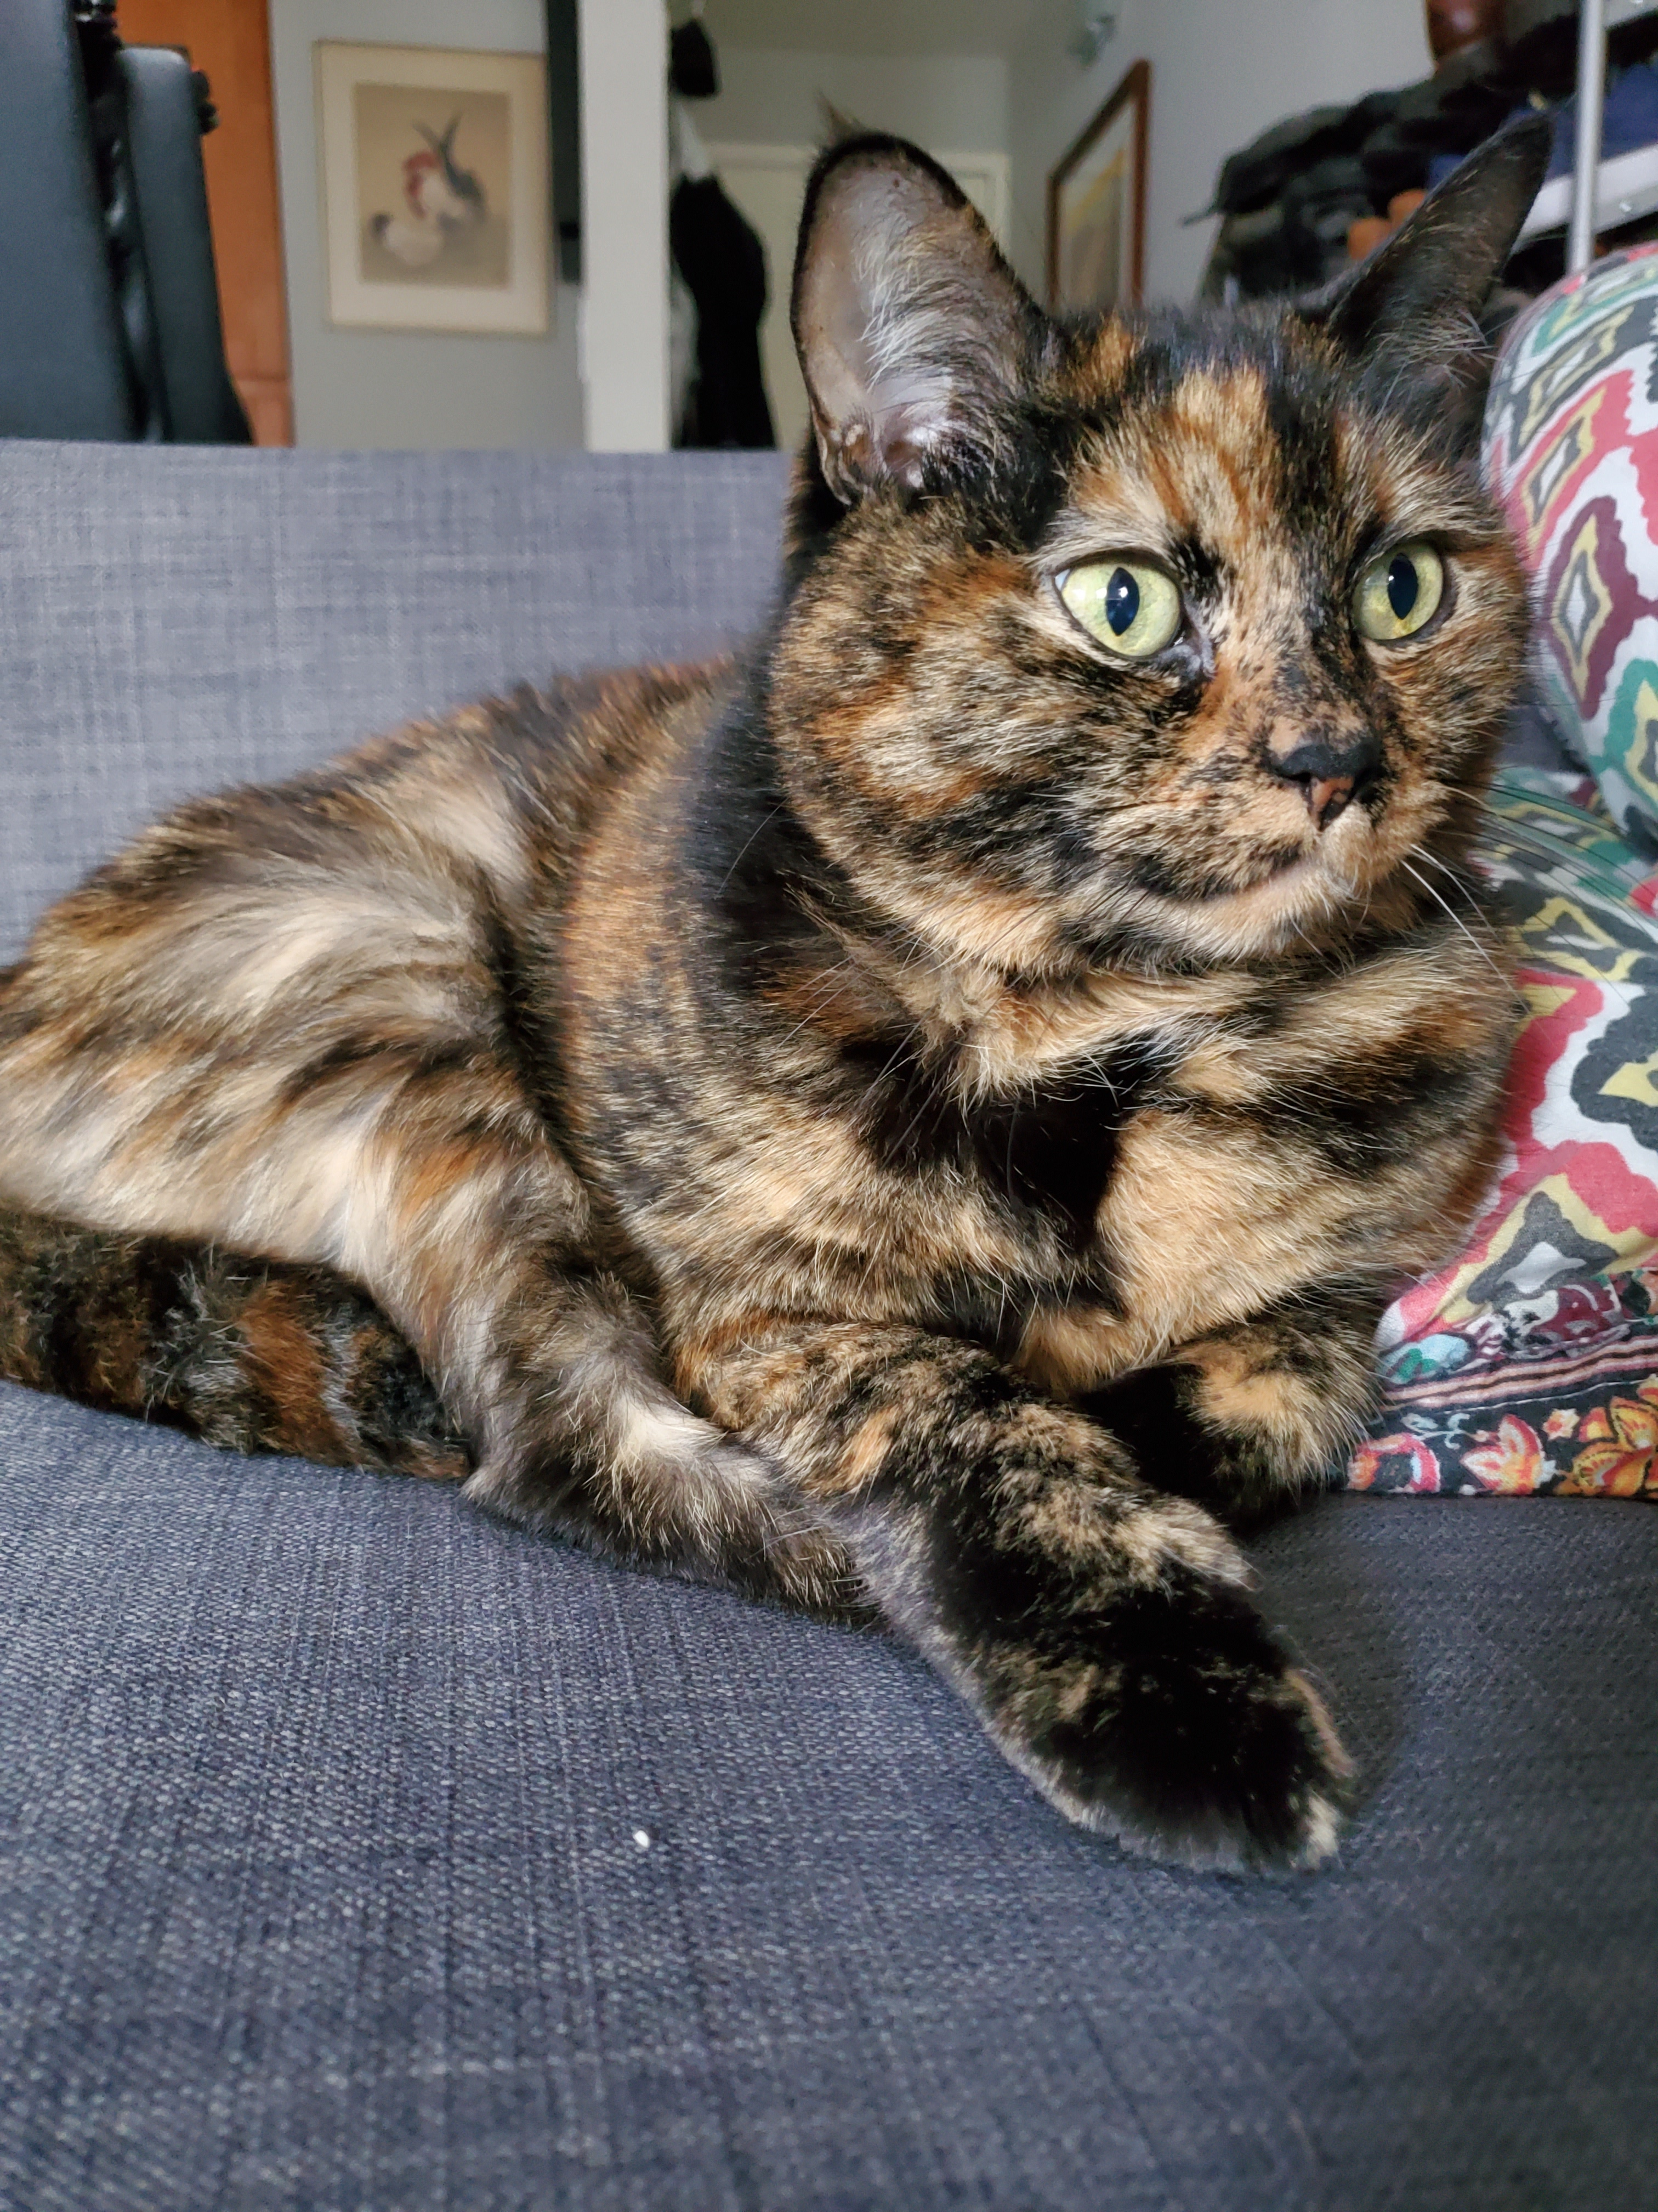
Questions?
kadm@uw.edu @kdillmcfarland Slides https://tinyurl.com/yxz9llyu

Slide 18
Claire Levy (she/her) : Why is it called "distributed" ?
Distributed refers to the idea that the complete history of a file is present on every computer that has a copy of that file. So, the history is disturbed along with the file. This is in contrast to “centralized” which means only the original file creator (or no one) has the history and if they were to share that file, the other person would only have access to that current version.
Kathie Sun : 1) How do you typically deal with clashes between different users/computers and reconciling or merging them?
GitHub has an interface for merging and dealing with what they term “conflicts”. This is a challenging aspect of collaborating on code for sure! My recommendation is to push to GitHub and merge frequently so that you don’t end up with a seemingly insurmountable list of conflicts at the end.
2) do you have a preferred editor that does a good job of showing the changes over time? thanks!
In command line, git log shows the history of the repo you’re in. On GitHub, you can go to a file and click its history (upper right) to see this.
Rebecca Butler : (1) how do you decide to just use the GitHub history vs making a new file?
It depends on your end goal. If you don’t want the current version, you can use the history to undo the changes you don’t want anymore. Like if you broke a script and want to go back to when it was working. If you still want the current version but want another copy to play around with, use a branch to protect the original and then if your changes work out, merge it back into the main branch to update that. Or if you don’t want to use a branch, you can copy the file and continue to track it with git. This is useful if you have some other code dependent on the current version and don’t want to break that while you, for example, add a feature

Slide 19
(2) for someone trying to get into GitHub via rstudio interface — is usethis valuable to learn? I’m hearing that some merge conflicts can’t be resolved via rstudio but am a bit intimidated by the command line.
I don’t have much experience with git in Rstudio unfortunately. I’ve found that the most complicated merge conflicts can’t be resolved even with usethis. So command line may still be needed. Or if you can push to GitHub, the online interface is friendlier
Pavitra Chakravarty : any difference between git and gitlab
I think of GitLab as hardcore GitHub. Lab is designed for program developers and has more control of permissions and continuous updating (instead of Hub where you have to tell it to push/pull)
Elisabeth A. Rosenthal : it looked like a pull worked both ways. Can you explain that?
Pull refers to getting files from GitHub and downloading/updating them on your computer, no matter the computer of user
Melissa Gaughan : best resources for learning R + git?
Shameless plug to my own workshop https://github.com/EDUCE-UBC/workshops/tree/master/R/reproducible_research
I first learned with the Carpentries http://swcarpentry.github.io/git-novice/
Monica: https://happygitwithr.com/
https://www.atlassian.com/git/tutorials
https://docs.github.com/en
Megsie Siple (she/her) : I am confused about the difference between git fetch and git pull. I have a local copy of one of my colleagues’ repos on my machine and I am not sure what the best practice is for updating it periodically.
Fetch puts the file in the staging area (or index). This means git on your computer knows the changes but hasn’t actually changed the file. They always work together. I think of fetch as me asking github if there is a reason to pull e.g. if my version is older than the one on github, I need to pull to update it

